Slide 1
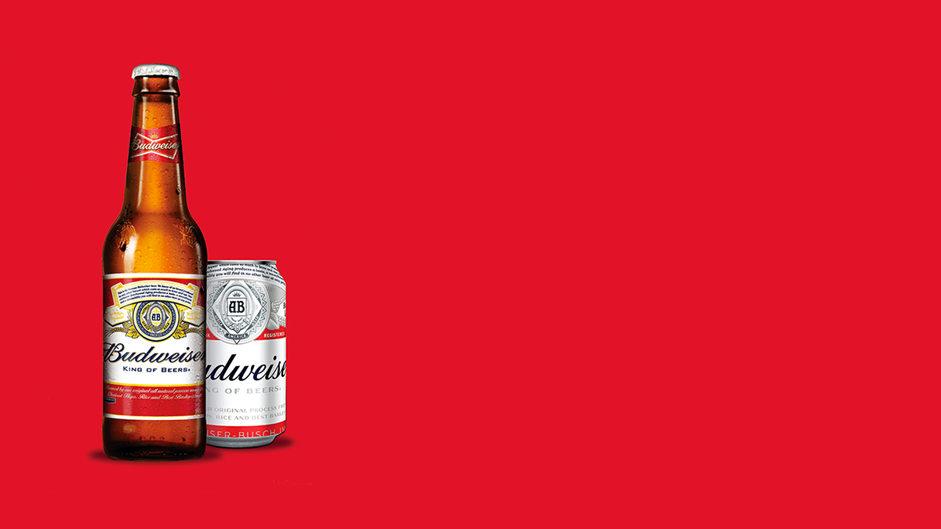
America’s Beers and Breweries A Data Analysis for Budweiser Andrew Taylor Unit 9 – Project 1 – Final Video Presentation Link

Slide 2

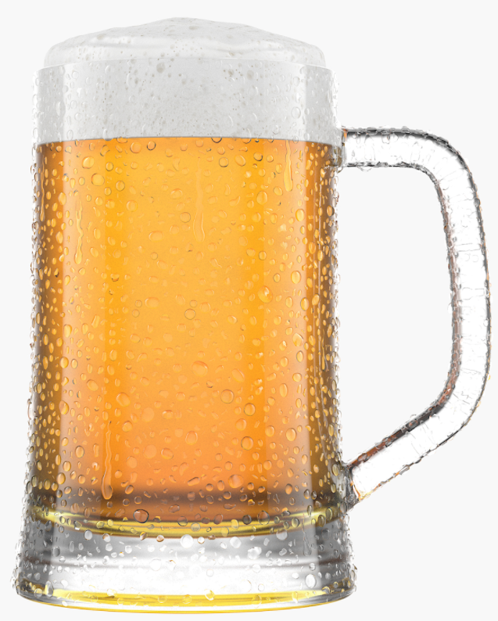
The Data
Boulder, CO
5.6% ABV
Size - 12 Ounces
NorthGate Brewery
Beer ID
43 IBU
Brewery ID
Style – American IPA
Three Kings Ale
Initial
2410 Beers
558 Breweries
Missing Values
Style - 5
ABV - 62
IBU - 1005
Final Data Set 1
– merged
- for ABV Analysis
- 2346 entries
Final Data Set 2
– merged
- for IBU and Relational Analysis
- 1403 entries
Missing Styles
Missing IBUs
Missing ABVs

Slide 3
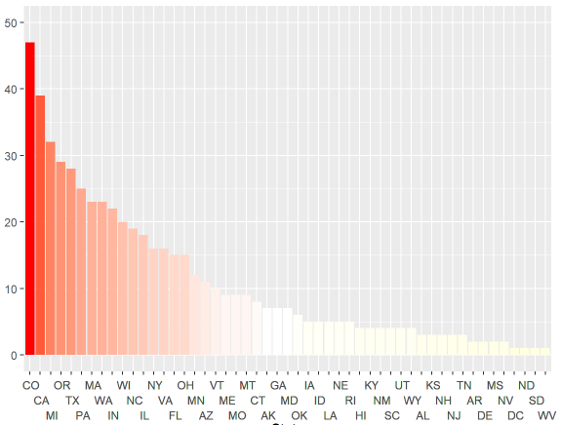
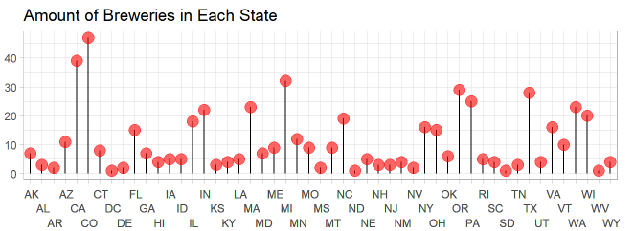
Breweries
Colorado – 47
California – 39
Michigan – 32
Oregon – 29
Texas – 28
.
.
.
Nevada - 2
District of Colombia- 1
North Dakota- 1
South Dakota- 1
West Virginia - 1

Slide 4
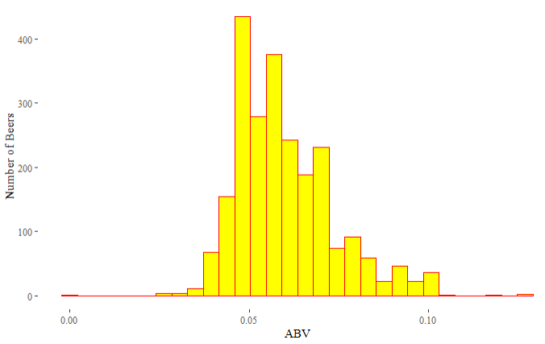
ABV – Alcohol by Volume
Maximum – 12.8%
- Lee Hill Series Vol. 5
- Belgian Style Quadrupel Ale
- Boulder, CO
Minimum - 0.1%
- Scotty K NA
– Low Alcohol Beer
- Santa Cruz, CA
Range – 0.1% to 12.8%
Middle 50% Range – 5.6% to 6.7%
Median – 5.6%
Average – 6.0%

Slide 5
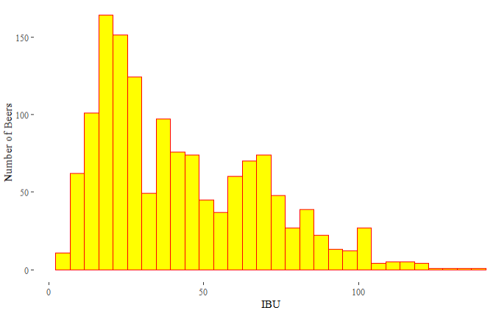
IBU – International Bitterness Unit
Maximum – 138
- Bitter Bitch
- American Double/Imperial IPA
- Astoria, OR
Minimum - 4
- Summer Solstice
– Cream Ale
- Boonville, CA
Range – 4 to 138
Middle 50% Range – 21 to 64
Median – 35
Average – 43

Slide 6
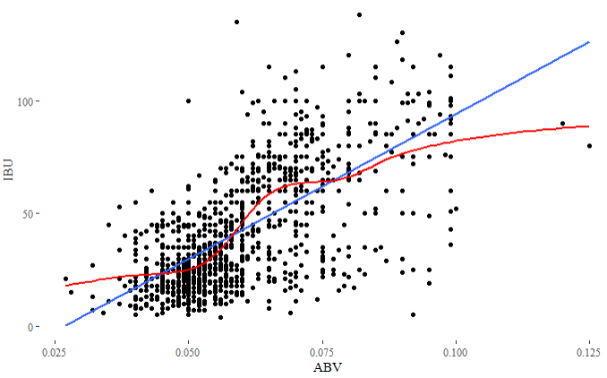
ABV vs IBU
67% positive correlation between ABV and IBU

Slide 7
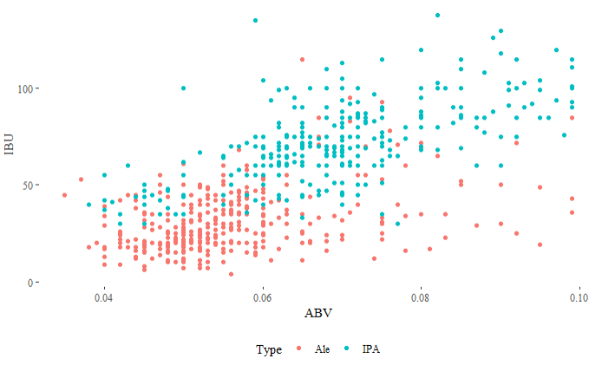
IPA vs Ale
KNN Model
Training Set – 20%
Best k-value - 5
Accuracy – 85%
Sensitivity – 87%
Specificity – 81%

Slide 8
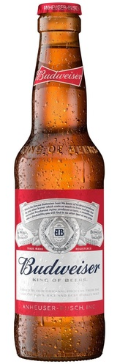
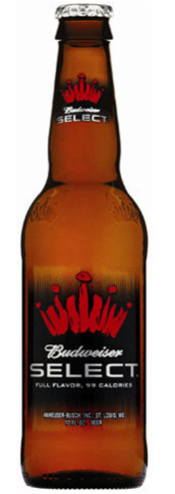
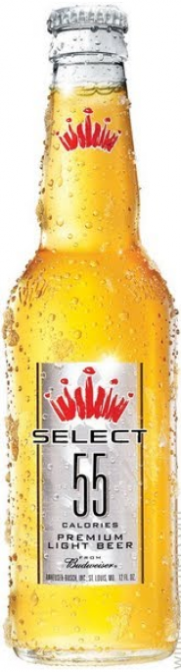
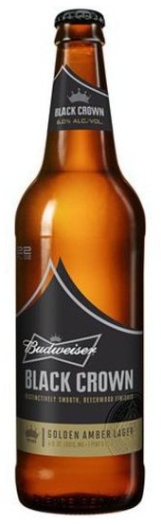
Keeping the Throne
Budweiser
American Pale Lager
5% ABV
12 IBU
Budweiser Select
Light Lager
4.3% ABV
11 IBU
Budweiser Select 55
Light Lager
2.4% ABV
10 IBU
Budweiser Black Crown
American Amber / Red Lager
6% ABV
15 IBU

Slide 9
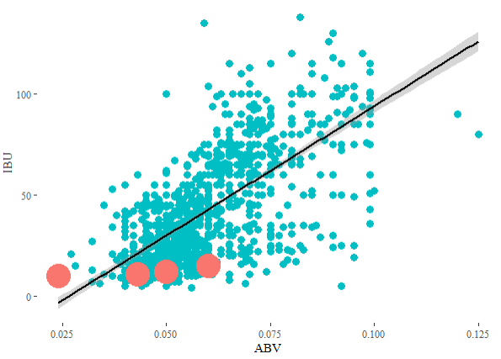
New Beer
Average Market Range
ABV - 5.6% to 6.7%
IBU - 21 to 64
Budweiser Range
ABV – 2.4% to 6.0%
IBU - 10 to 15
Recommendation
ABV – 6.9%
IBU - 43

Slide 10
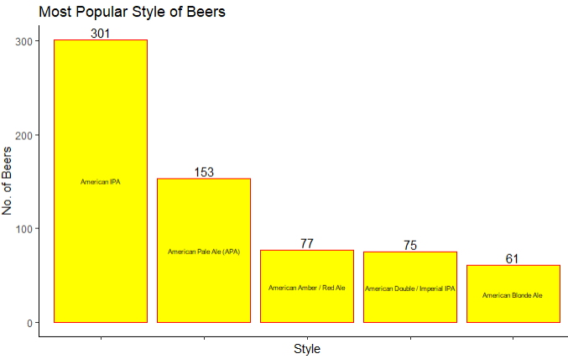
New Beer
Budweiser Beer Styles
2nd - American Pale Lager
3rd - American Amber/Red Lager
63rd - Light Lager
Recommendation
Create an American IPA as it by far the most “popular” brewed beer in America

Slide 11
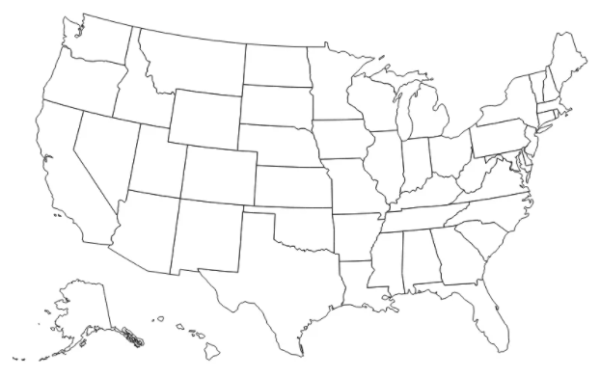
New Brewery
Popular Brewing States
Colorado
California
Michigan
Oregon
Texas
Pennsylvania
Massachusetts
Budweiser Breweries
New York
Georgia
Ohio
California
Texas
Florida
Missouri
Recommendation
Open a brewery in Colorado or Michigan

Slide 12

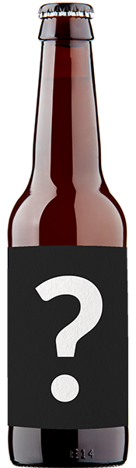
Long Live the King
American IPA
6.7% ABV
43 IBU
Brewed in Colorado

